Slide 1
Tracking potholes , noise level(DB) MEASUREMENT, ILLUMINATION LEVEL MEASUREMENT AND MAPPING ON GOOGLE MAPS TITLE : SMART CITY ENABLER
TEAM MEMBERS
SILLA SHRADHANJALI
ATUL KUMAR AGARWAL
SUPRIYA MUDULI
ANJALI SUBUDHI
ASHRITA SAHU

Slide 2
PROBLEM STATEMENT
Tracking of potholes and measurement of noise level(dB) & illumination level(LUX) in cities and mapping these on Google maps –”SMART CITY ENABLER”. Develop a system to measure and map noise and illumination level in cities along with the tracking of potholes for the comfort and safety of commuters as well as improvement of urban planning.

Slide 3
CONTENTS
1.Introduction
2.Situation and problem overview
3.Proposed Design & Idea
4.Advantages
5.Estimated budget and timeline
6.Limitations
7.Future plan
8.Conclusion
9.Reference

Slide 4
1.INTRODUCTIOn
1.Technology has the power to improve people lives by using data and electronic sensors and can build a smart city.
2.With this motivation in the mind our project aims at designing0 and implementing a running model of smart city enabler vehicle.
3. We track potholes , measure noise level(dB) & illumination level (LUX) in cities and map these on Google maps.
4.We will use ultra sonic sensors and Piezo electric sensors for pothole hole detection ,BH170 sensor for illumination level, sound sensor{L393} for noise level , and IR sensor on poles to measure density of traffic.

Slide 5
2.SITUATION & PROBLEM oVERVIEW
Metro politian cities public are unaware about the road conditions at different parts of the city . They need a guide to help themselves . The main idea behind the solution is to gather the information or data regarding different road conditions and map it on Google maps.
The mapping will not only help public to be aware of his environment and thus take precautionary measures to evade accident but also alert the respective authorities to take suitable measures to improve the road conditions , reduce noise level of a particular area or make the brightness level of a place more or less as required.

Slide 6
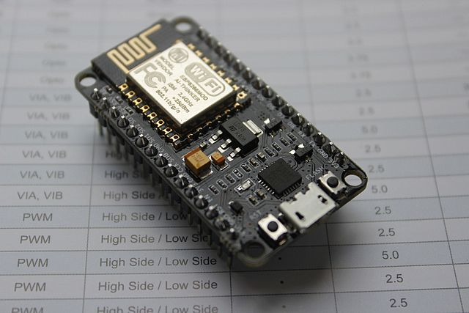
3.PROPOSED DESIGN
Web app: user have to upload the location of potholes , illumination level of different area in the app and later viewed using goggle map for geotagging purpose.
Node MCU:
it is an open source IoT platform . It includes firmware which runs on the ESP8266 Wi-Fi SoC from Espressif Systems ,and hardware which is based on the ESP-12 module. The term “Node MCU” by default refers to the firmware rather than the development kits.
ESP8266 is a low cost ,Wi-Fi Module chip that can be configured to connect to the internet for internet of things[IoT] and similar technologies.
Advantages:
1.Interactive
2.Programmable
3.Low Cost
4.Simple Interface
5.Smart IoT enabled with inbuilt Wi-Fi
6.Arduino Compatible

Slide 7
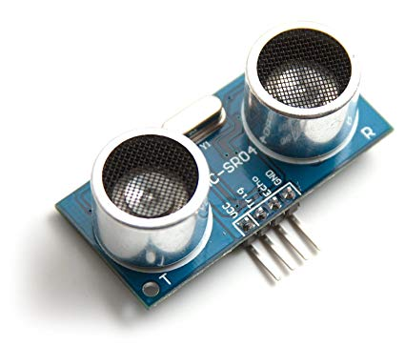
Sensors used Sensors to accurately track the potholes,measure noise level and illumination level > Ultrasonic sensors > IR sensors > Li-Dar sensor
ULTRASONIC SENSORS
Ultrasonic sensors measure distance by using ultrasonic waves . It measures the distance between the car body and the road surface and this data is recieved . The distance between car body and the ground ,on a smooth road surface , is the threshold distance . Threshold value depends on the ground clearance of vehicles and can be configured accordingly. If the distance measured by the sensor is greater than the threshold , it is a pothole,if it is smaller,it is a hump otherwise it is a smooth road.

Slide 8
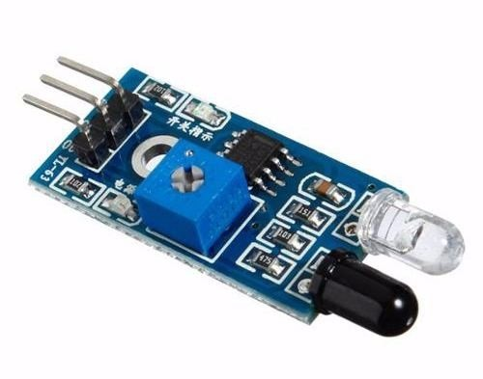
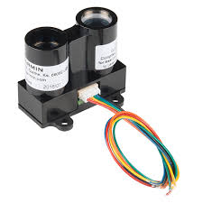
IR SENSORS -
An IR sensor can detect the motion.
The emitter is simply an IR LED ( Light emitting diode)and the detector is simply an IR photodiode which is sensitive to IR light of the same wavelength as that emitted by the IR LED.
When IR light falls on the photodiode the resistances and these output voltages ,change in proportion to the magnitude of the IR light received.
Thus we can determine the density of traffic.
Li-Dar SENSORS
Li-Dar is a surveying method that measures distance to a target
By illuminating the target with pulsed laser light and measuring the reflected pulses with sensor .we can use the LiDar sensor for pothole detection but in out project we are not using this because of the following disadvantages:
High operating costs in some applications.
Ineffective during heavy rain or low hanging clouds.
The laser beam may affect human eye in cases where the beam is powerful.
Requires skilled data analysis techniques.

Slide 9
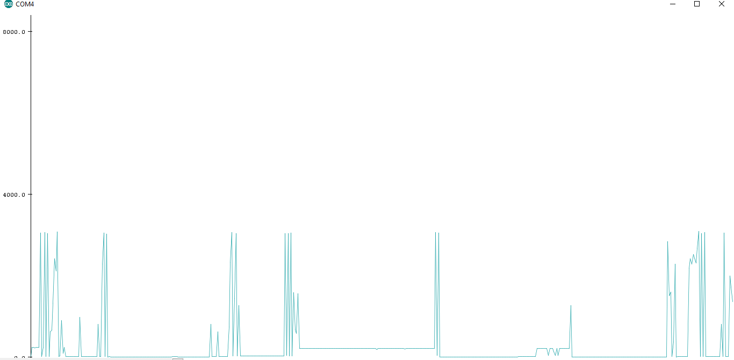
ULTRASONIC SENSOR

Slide 10
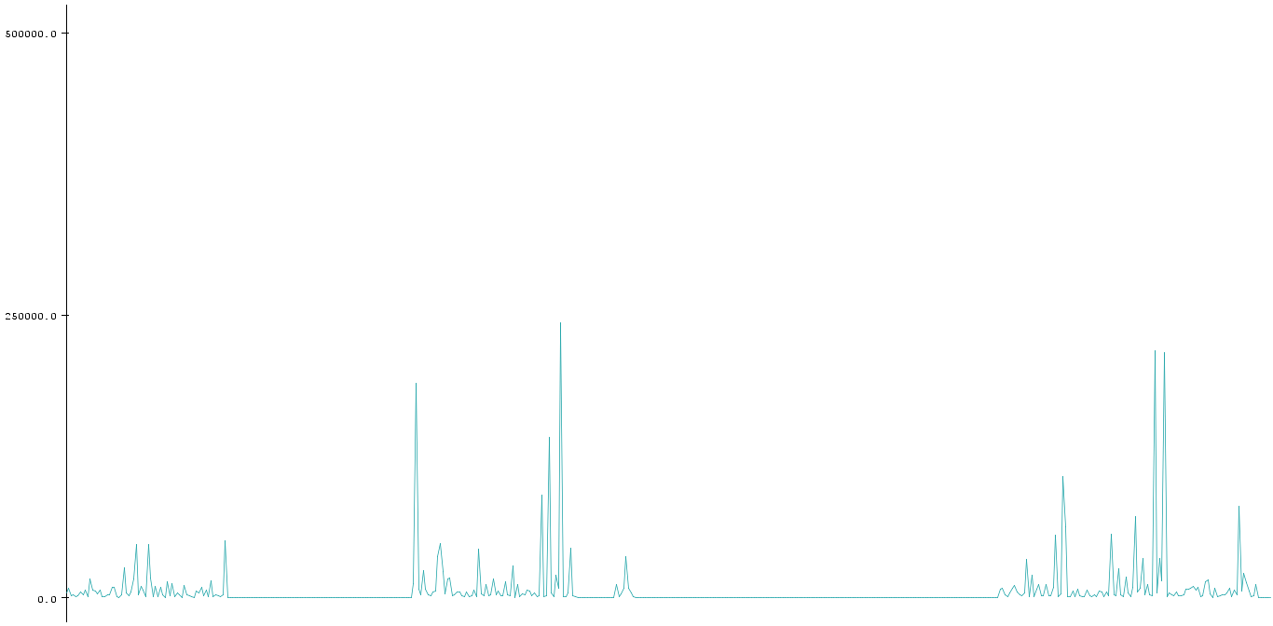
VIBRATION SENSOR

Slide 11
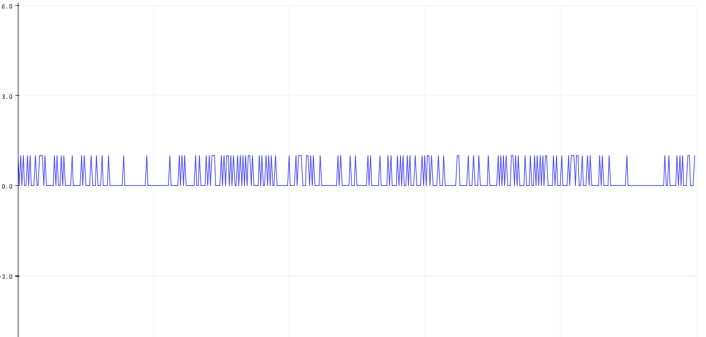
SOUND SENSOR

Slide 12
3.PROPOSED IDEA
The different sensors attached to the vehicle like ultrasonic sensor and vibration sensor is used to determine the potholes. The real time data about the presence of pot holes and the illumination level of different area are transmitted to the firebase using Node MCU by different users.
The sound sensor and IR sensor attached to the poles beside the road sends the real time data about the sound density and vehicle density of that area .
Based on the sending datas a Web app has been designed to alert regularly about the potholes ,sound density , vehicle density and illumination level of different area to the users .

Slide 13
4.ADVANTAGES
Drivers safety can be improved .
Efficient system for long lasting solution.
Compact & easy to setup in any area.
Efficient sensors integration and economical.
Efficient and flexible code .
Automatically map the collected data in google map.
The model is scalable for smart cities over wide areas.

Slide 14

5.ESTIMATED BUDGET AND TIMELINE
Things used and price estimation
Node MCU-Rs350
IR sensor-75
Ultrasonic sensor-Rs 80
L393 sound sensor -Rs 100
L298 motor driver –Rs 150
Total-Rs 755

Slide 15
6.LIMITATIONS
The city should be Wi-Fi enabled.
Most of the vehicles running around the city should be integrated with the required sensors.

Slide 16

7.FUTURE PLANS
This timely information can help to recover the road as fast as possible . By controlling the rate of fuel injection we can control the rotation of the drive shaft by means of an IR Non contact tachometer .This helps to reduce the vehicle speed when pothole or humps is detected . Hence the system will help to avoid road accidents.

Slide 17
8.CONCLUSION
The implemented application enables the users to reach a destination from a given source based on vehicle density ,illumination level ,sound density and it also detects the potholes and warns the user about the same. Thus , ensuring the safety of commuters.
Overall , the application concentrates on helping the corporation by reporting the condition of the roads and also helping the commuters the drive safer.

Slide 18
THANK YOU

